Slide 1
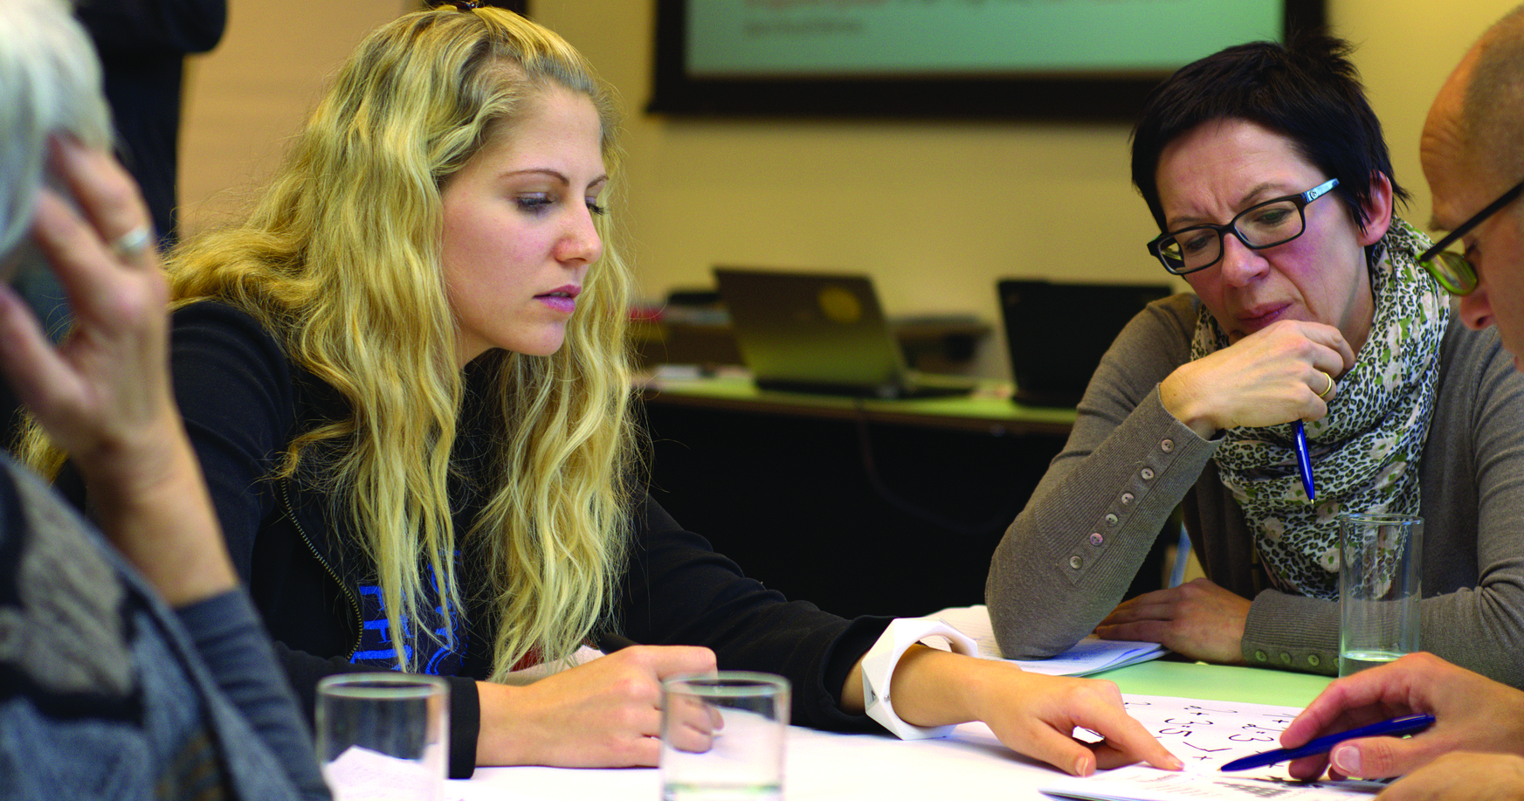
The Best Software Language
Hamid nahli, jesse law, Mimi Southwood, Nichelle garvey, ricky brown
It 115, group 2
May 2022

Slide 2
Our Survey

Slide 3
Team Recommendations

Slide 4
HTML
Ricky Brown

Slide 5
CSS
Nicole Garvey

Slide 6
JAVASCRIPT
Jesse Law

Slide 7
MySQL
Mimi Southwood

Slide 8
Python
Hamid Nahli

Slide 9
Use of GitHub

Slide 10
1. JESSE - How did you change Code Compare?

Slide 11
1B. JESSE – READ.ME, CONTRIBUTING.md, License

Slide 12
2. MIMI - How did your team collaborate and manage the project 3. MIMI - What roles did each team member play?

Slide 13
2B. MIMI – Project Page – ALL Contribute

Slide 14
4. NICOLE – Describe your process for testing 5. NICOLE – Describe your process for bug tracking 6. NICOLE – How did you update and fix code?

Slide 15
4B. NICOLE – Bug reports project board

Slide 16
7. RICKY – What web server are you using to host your project? 8. RICKY – Describe the process for configuring your web server

Slide 17
7B. RICKY – Super-linter workflow

Slide 18
9. HAMID – How did you deploy code to your server? 10. HAMID – Provide a URL so others in your class can playtest your project

Slide 19
9B. HAMID / RICKY – All project pages and all assets – ALL CONTRIBUTE

Slide 20
Questions?

